Slide 1
Meet Frank – A basic statistical tool
My project was a simple statistical tool that runs a number of statistical tests on data and returns all the results – tagging significant information
The theory is this could be a useful entry tool for non-programmers to data analysis. It indicates some basic relationships between the data points and tests all paired variable combinations as opposed to testing variables piecemeal.

Slide 2
Data Pipeline
I was hoping the final tables would be a little less ugly – but Numpy and Pandas got the better of me
Excel Doc 1 ----> Contains Data
Clean Data
Python -> Import all data – convert to usable format (Numpy)
Make fun charts and graphs with new data
Python -> Run Statistical Tests
Tag data

Slide 3
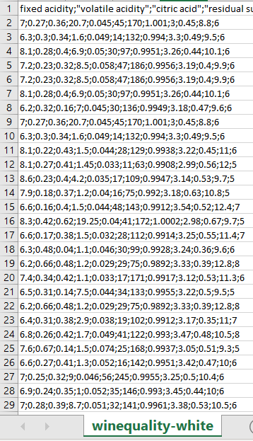
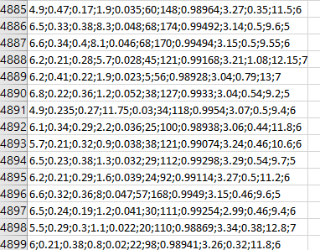
Raw Data
Frank used the Wine Quality Data Set from the UCI machine learning Repository. There are 12 variables in total and 4828 pieces of data
A minor issue is that frank was built to deal with continuous float variables (the type within the dataset). This means the code will need different tests and some modification to look at categorical and ordinal variables. There are also specific tests for time-data etc

Slide 4
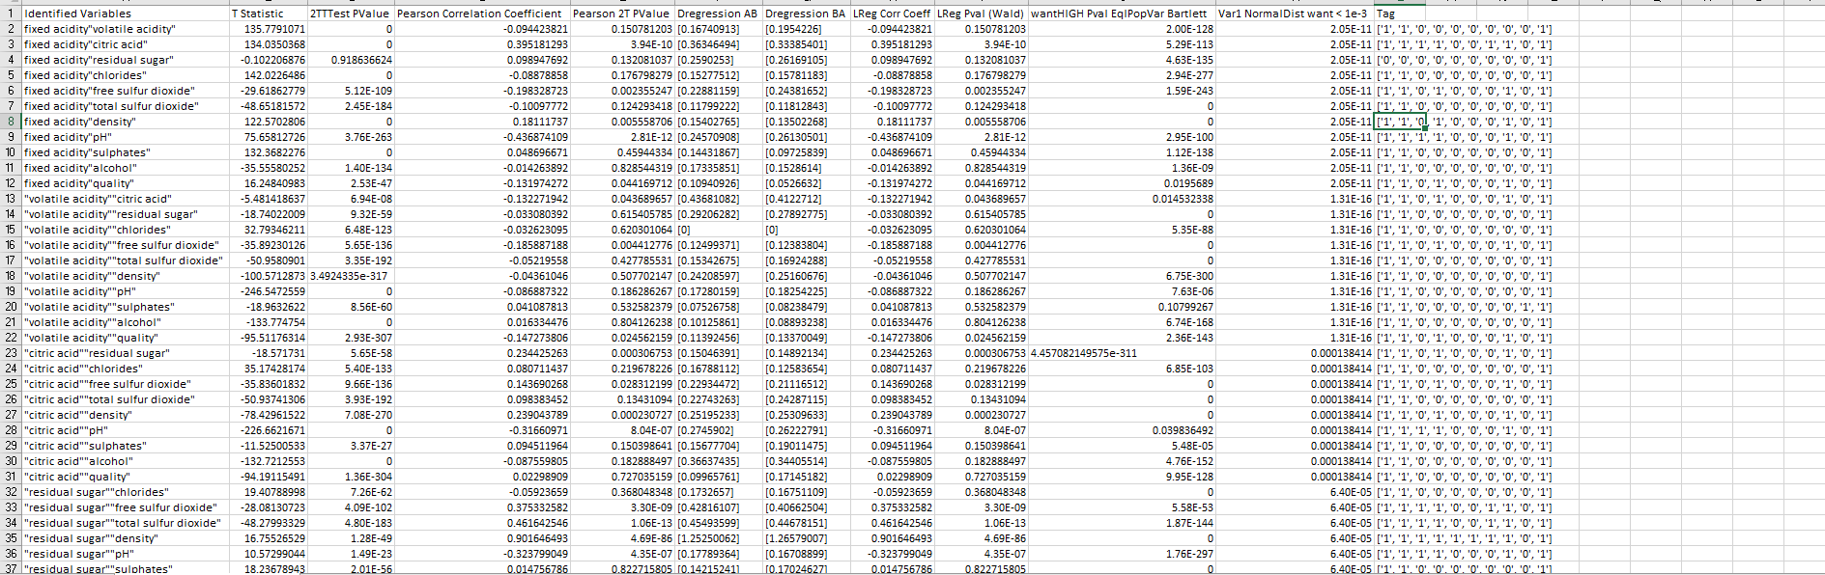
Base Analysis
This document – although unwieldy, contains a small host of test results and flags the relevant ones. I removed basic information such as standard error and mean tests for space reasons as the page was getting unwieldy – albeit the functionality is still there.
In hindsight – the dataset probably had too many correlations

Slide 5
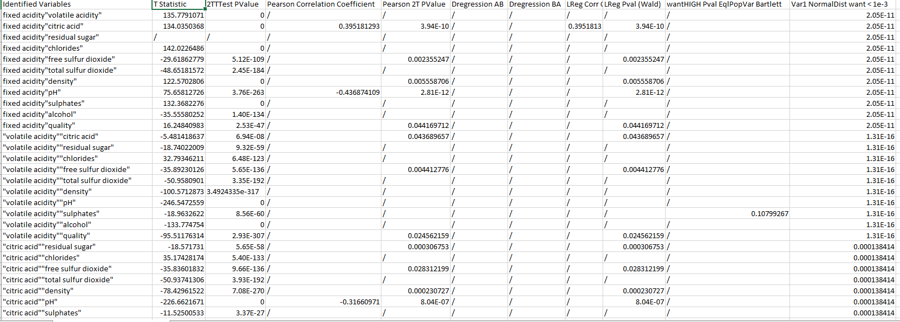
Different View
This document only keeps data that it considers of statistical relevance (according to the tags.) Remaining data is replaced with a /

Slide 6
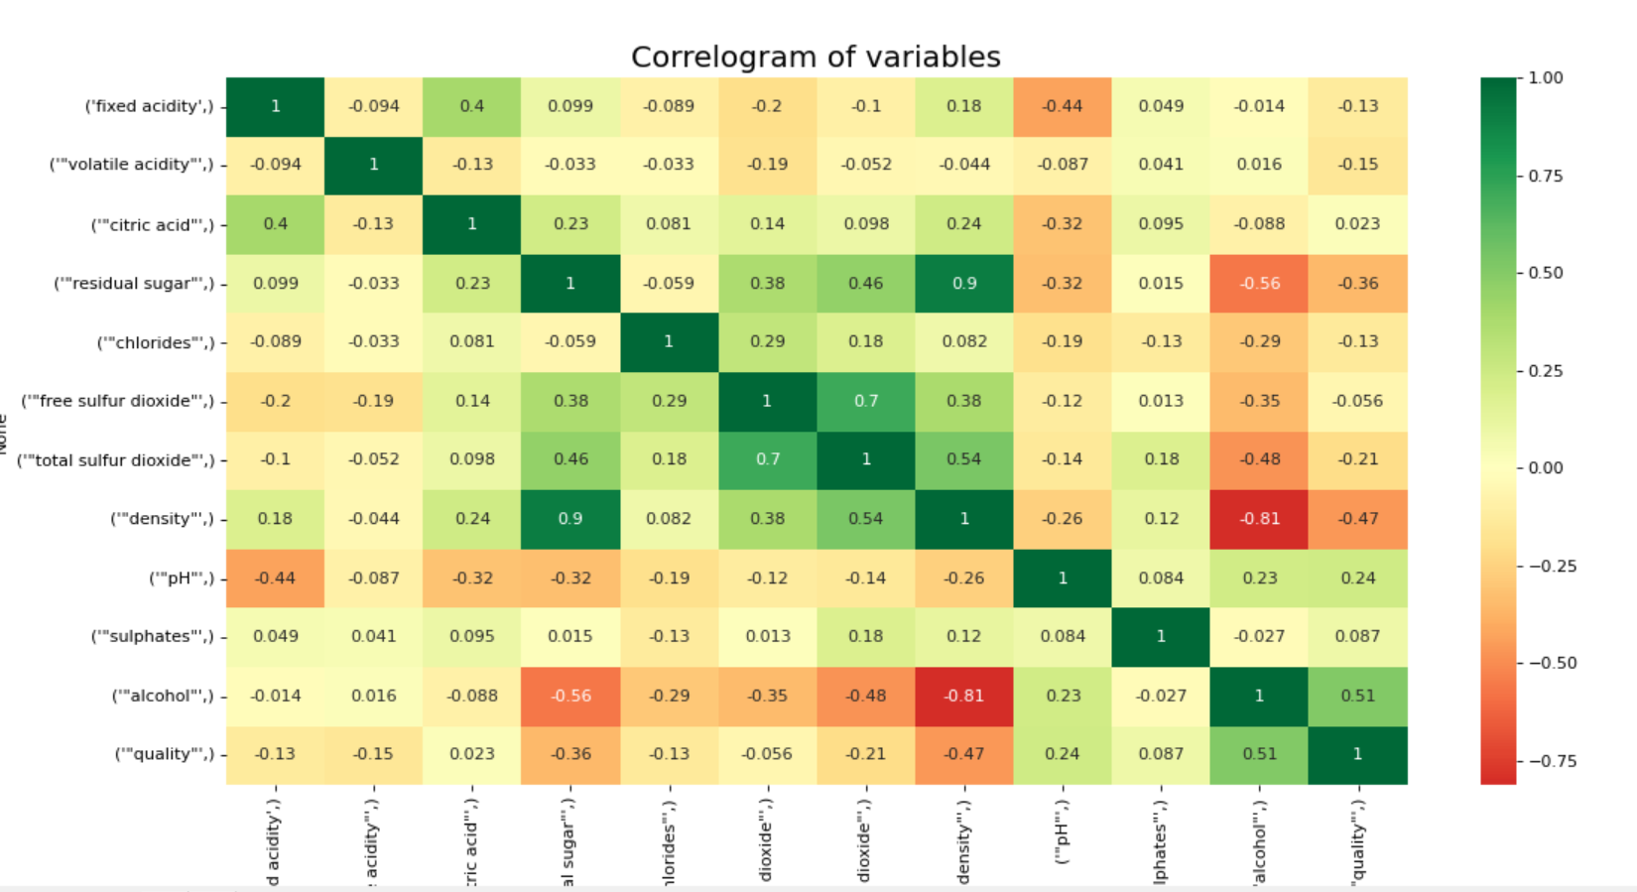
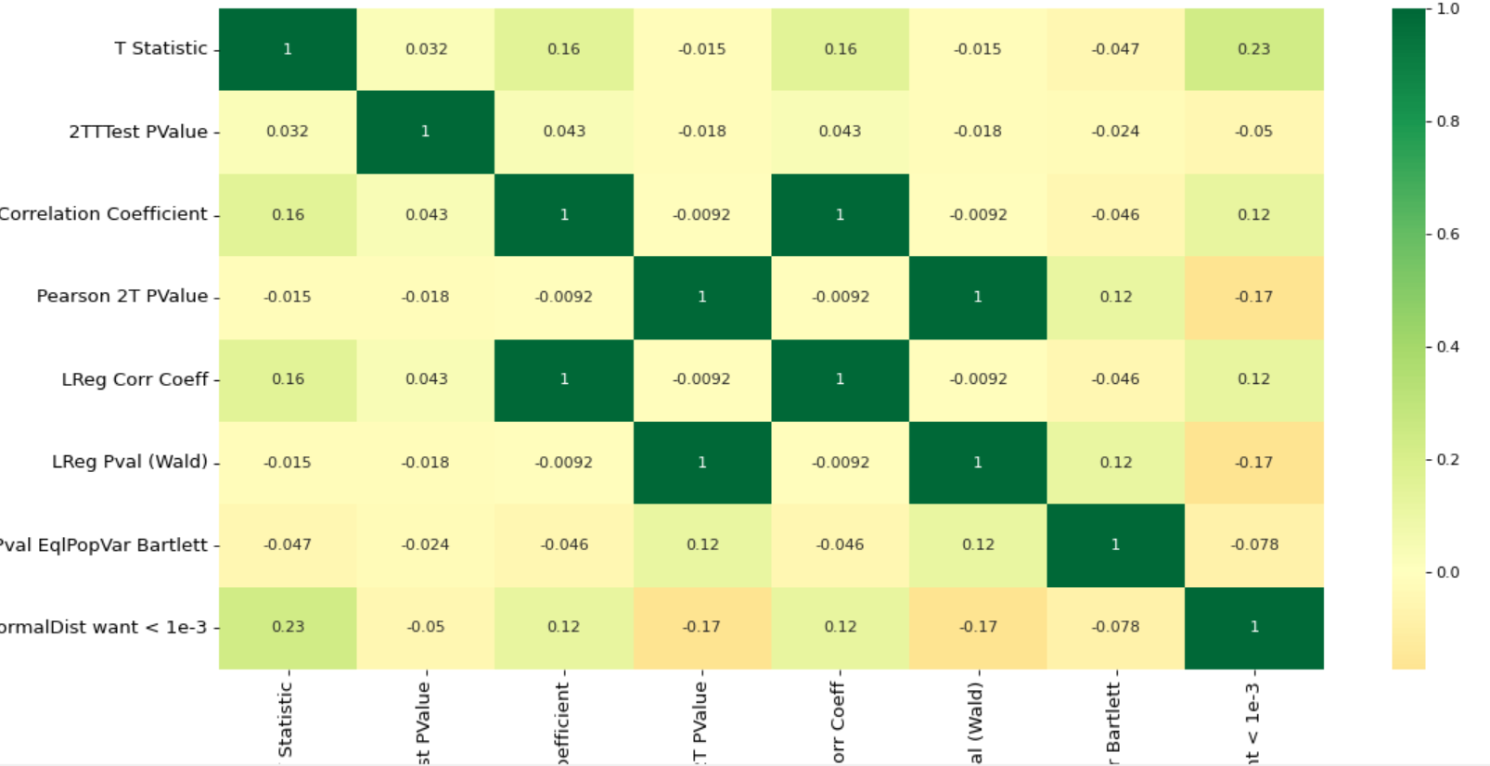
Basic Graphs based on data
I added two correlation matrices to help highlight key data points.
The first is ordinary.
The second tests the correlation of all the test results. The graph itself is of (extremely) limited statistical significance, however it highlights how the new block of relevant statistical tests can be used for further testing.

